Slide 1

F5 & HashiCorp
SMOKE THE COMPETITION
Notes:
We have a saying at F5, “every app is an opportunity”
State of Application Strategy Report:
29% of customers are moving applications out of the cloud
That’s not to say they are cancelling their cloud plans, it’s that they are getting more intelligent about how they use cloud
More customers are going to hybrid environments, running larger monolithic applications in a private cloud or a data center, and modern applications developed with microservices in public cloud
These customers also told us that covid has dramatically accelerated their plans for Digital transformation
With Covid, you do business through your applications or you die, and this forced customers to accelerate their modernization plans…and in most cases this is no longer the CIO saying “we are moving 100% of our apps to Amazon”.
At F5 we’ve known for a long time that apps drive out business.
2 years ago we changed our account structure.
Digital, Commercial, Majors, FinServ, Fed and SP
Digital scale
Commercial became a focused or with named accounts
Docusign, Zillow, TicToc, Airlines, credit unions, regional banks…ecommerce…a mix of mid and large accounts
Since then we have seen our business explode…
6 quarters of sequential growth
5 quarters of double digital growth
For the first six months of our fiscal, we’ve grown 35% year on year in Commercial

Slide 2

CONTRATULATIONS
LEADERBOARD
Name | Partner | Total Points
Colby Canutt | Optiv | 1200
Justin Stevens | Bridge Data | 1200
Dave Unger | InterVision | 800

Slide 3
Checkpoint 3 - Review
Question: How many pool members was Eric able to quickly scale up to at the end of the video using Consul Terraform Sync?
Answer - 100
Question: What did James forget to do?
Answer: He forgot to show the app actually working.

Slide 4
F5 Security Strategy for Zero Trust

Slide 5


F5 in the NIST Zero Trust Architecture
Control Plane
Policy Engine
Data Access Policy
Policy Decision Point (PDP)
Policy Administrator
Enterprise PKI
Acts as the PDP and PEP
ID Management
Untrusted
Policy Enforcement Point (PEP)
Trusted
Subject
System
Enterprise Resource
SIEM System
Data Plane

Slide 6

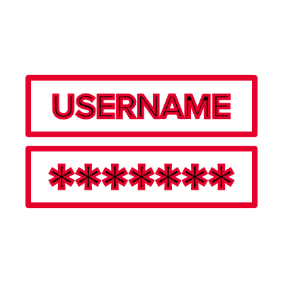



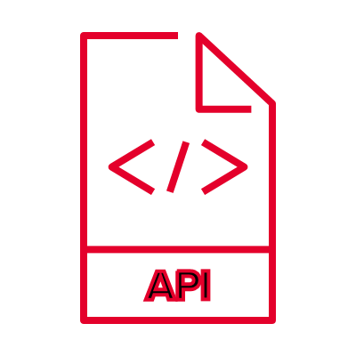

F5 addressing Zero Trust Threats
Addressed by:
F5 Advanced WAF with Leaked Credential Check
Shape Enterprise Defense
Silverline Shape Defense
Addressed by:
F5 Advanced WAF
NGINX App Protect
NGINX App Protect L7 DoS
Silverline WAF
Silverline DDoS Protection
Silverline Shape Defense
BIG-IP AFM
Stolen / Leaked Credentials
Addressed by:
BIG-IP APM
F5 Advanced WAF
Silverline WAF
NGINX WAF
BIG-IP AFM
DoS / DDoS Attack(s)
Storage of System / Network Info
Addressed by:
F5 Advanced WAF
Silverline WAF
NGINX App Protect
NGINX Controller
BIG-IP APM
Volterra VoltMesh
Aspen Mesh
Addressed by:
F5 SSL Orchestrator
Use of Non-person Entities (NPEs)
Network Visibility / Encrypted Threats

Slide 7
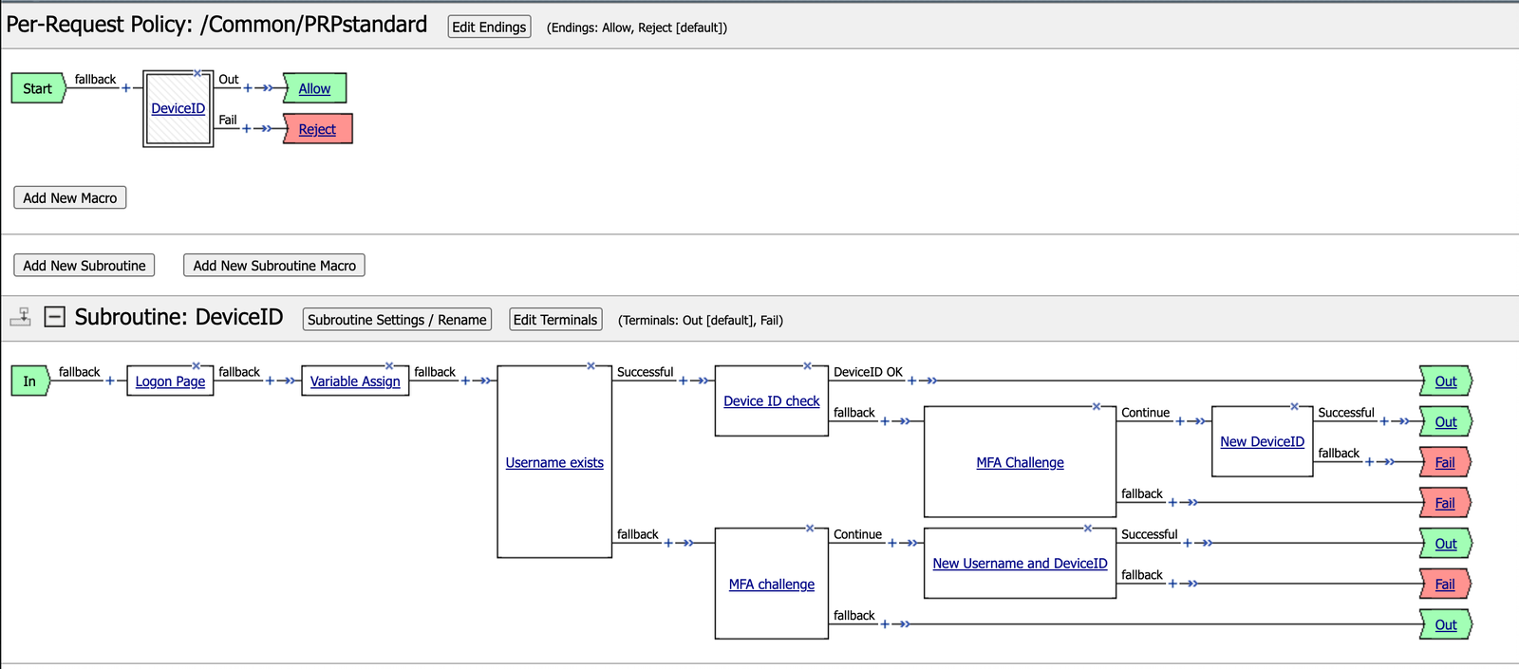
Example Zero Trust Policy with DeviceID+

Slide 8







The Shape Platform
Enterprise Defense
Identify and mitigate unwanted traffic
Bots
Human Clickfarm
SAFE
Identify fraudulent user behavior
Manual Fraud Actors
Recognize
Create a friction free user experience and increase revenue
Good Customers

Slide 9
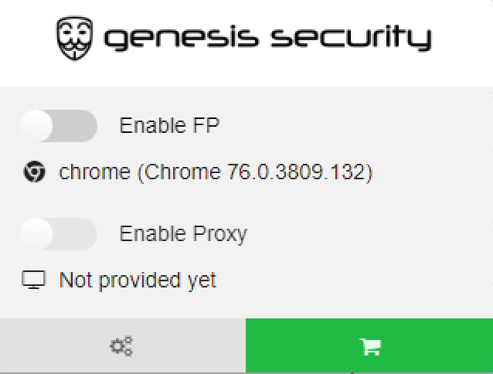




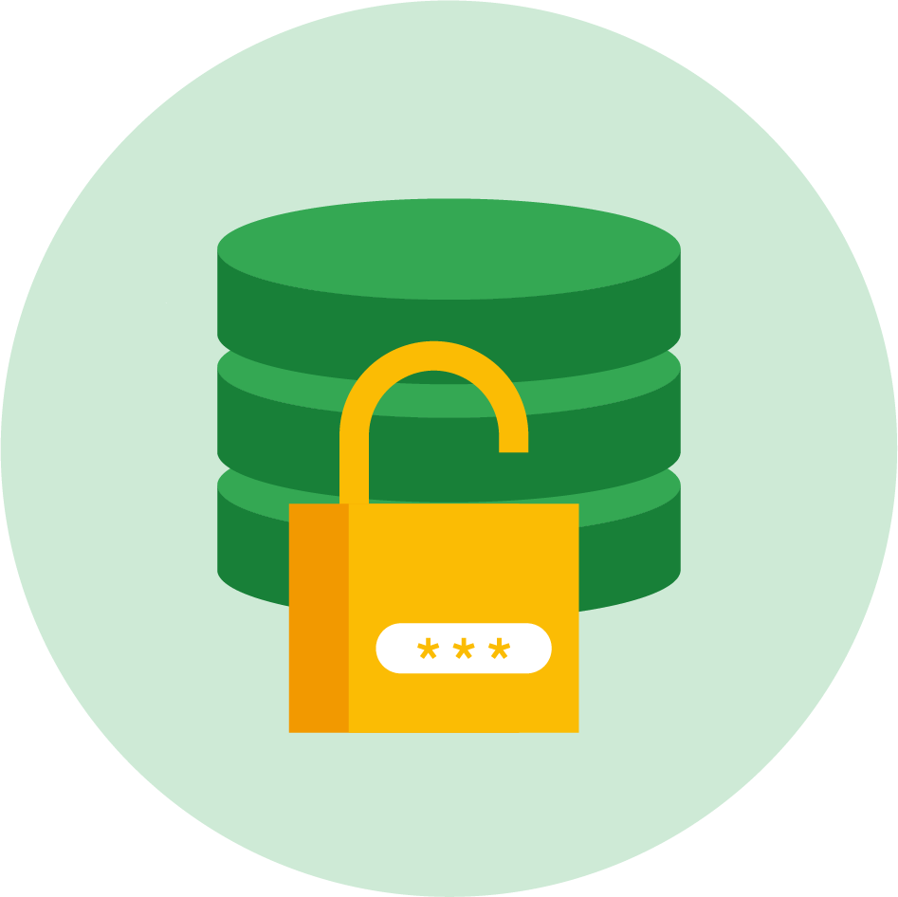








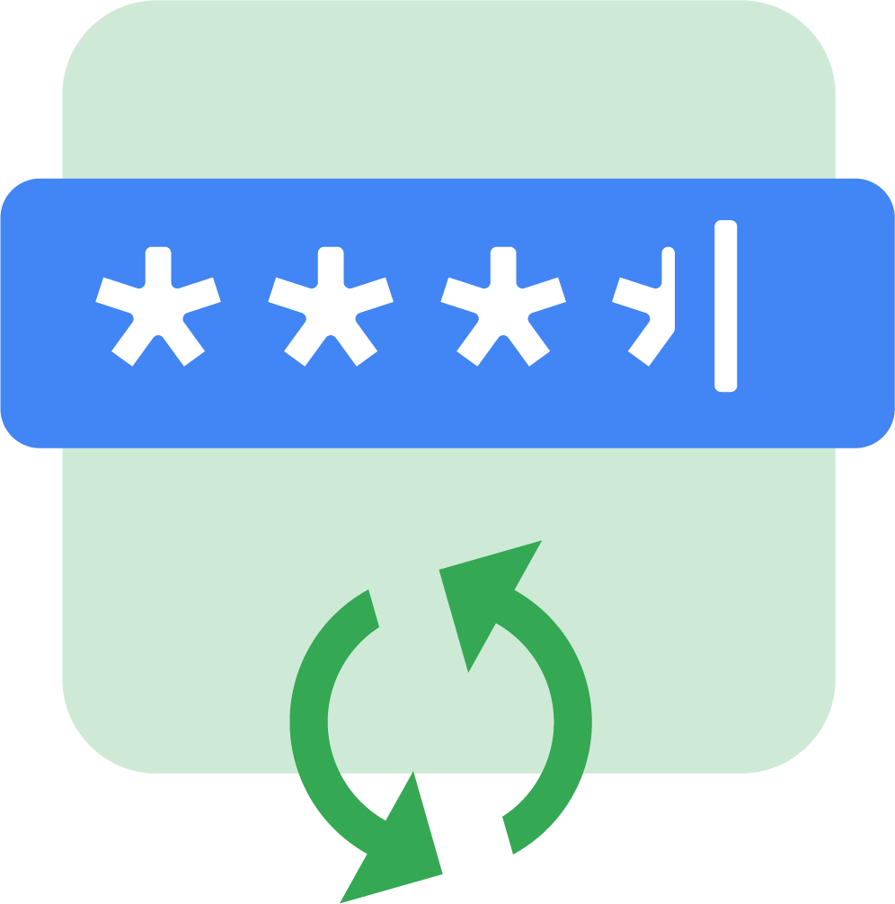
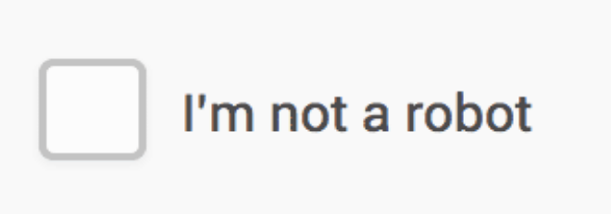



The accelerated attack lifecycle
It starts with unwanted automation and Ends with Account Takeover and application fraud
Credentials are Stolen
Stolen Credential Database is built
Accounts are Compromised
Leading to
Fraud & Friction
Automation
Sophisticated
Social Engineering
Targeted Attacks
Data Breach
Phishing
Keyloggers
Financials
Identity
BFP
Device
ID
Over 1 Million stolen credentials are reported every day
The black market has industrialized cyber crimes and fraudulent activities
Automation, malicious bots, and manual attacks expose users and businesses to fraud
Leading to 65% increase in successful fraud attempts from 2019 to 2020

Slide 10









The Future: Single view of customer trust & safety
Business &
Customer Exp
Security
Risk
Secure Digital Experience
Reduce Fraud Loss
Increase Revenue
Industry leading ML
F5/SHAPE Digital Risk Engine
TELEMETRY
TELEMETRY
Unified, Secure-Telemetry across the customer journey
{ API }
Network Layer
App Layer
API Gateway
Identity & Authentication Analytics
User behavior Analytics
Customers
Signup Login Activity Transaction
Notes:
ToDo:
Reduce the 7-8 areas (app/web server, ingress controller, api gateway, load balancer, app security, DNS, DDoS) into 2-3 unique kinds of signals (complementary to the other purple ones) that F5 can use in the risk engine

Slide 11



SAFE delivers differentiated outcomes in real-time
Machine Learning models dynamically adapt to ever-changing fraudster human behaviors
LESS FRAUD
LESS FRICTION
LESS EFFORT
SAFE typically identifies 2x-5x more fraud per month than current solutions, while maintaining low false positive levels
SAFE recommends up to 90% FEWER MFA challenges for legitimate users than alternative solutions - less user friction for legitimate users means more revenue
SAFE slashes the # of transactions that require fraud team review
by more than 50%
Typical SAFE Return on Investment: 6-10 weeks
Notes:
Copy and paste if more cards, scale them, then center the whole content

Slide 13
Zero-Trust with
HashiCorp
https://www.hashicorp.com/solutions/zero-trust-security

Slide 14


The migration to cloud security
Traditional Datacenter
Static
Modern Datacenter
Dynamic
Defend the Perimeter
+
Inoculate the Interior
=
Defense in Depth

Slide 15
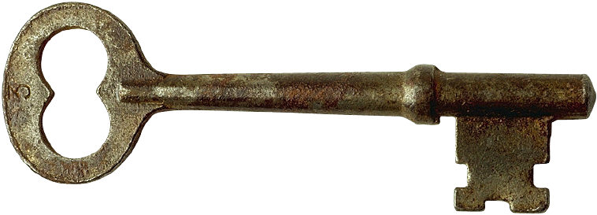
The migration to cloud security
Traditional Datacenter
Static
Modern Datacenter
Dynamic
Defend the Perimeter
+
Inoculate the Interior
=
Defense in Depth
Trust Nothing ...
Identify and firewall everything
Encrypt everything at rest
Encrypt everything in flight
Notes:
Not getting rid of perimeter, just building on it
Security strategy is now arguably MORE important

Slide 16


Multi-cloud security in a “Zero Trust” world
CORNERSTONE CONTROLS
Terraform
1000+
Providers
IDENTITY-DRIVEN CONTROLS
Vault
Consul
Boundary
SSO
Machine Authentication & Authorization
Human Authentication & Authorization
Machine-to- Machine Access
Human-to- Machine Access
Notes:
Terraform is the provsioner; we want to enforce policies for security upfront, not post deployment
All of these can be configured with Terraform

Slide 17

Unlocking the Customer Journey to COM
Cloud Essentials
Shared Services
Common Logical Architecture
MILESTONES
ESTABLISH CHAMPIONS
DELIVERING SHARED SERVICES
EXTENDING TO ADVANCED SCENARIOS
AUDIENCES
Practitioner: Devops, Secops, IT Infrastructure, Admin, ...
Decision Maker: Director, VP, CISO, CIO, ...
SCENARIOS
Container Orchestration
Heterogeneous Workload Orchestration
Common Service Registry
Health Monitoring
Network Infrastructure Automation
Service Mesh
Secrets Management
Encryption as a Service
Advanced Data Protection
Infrastructure as Code
Compliance & Governance
Self Service Infra
Notes:
Establish Champions:
The customer knows very little about HashiCorp products or the process change we enable. This early stage of the customer journey is focused on vision setting and presenting what’s possible.
If the customer has already purchased one HashiCorp product, they will likely have a low awareness of the HashiCorp portfolio behind their initial investment. In this instance, introductions of the other products and the applicable use cases that reinforce/amplify their existing HashiCorp investment will drive incremental opportunities.
Shared Service
The customer already operates HashiCorp enterprise products in their infrastructure, and is ready to make a large investment. They know about multiple products already. This is stage of the journey towards the Cloud Operating Model is about building trust.

Slide 18
Unlocking the Customer Journey to COM
Cloud Essentials
Shared Services
Common Logical Architecture
MILESTONES
ESTABLISH CHAMPIONS
DELIVERING SHARED SERVICES
EXTENDING TO ADVANCED SCENARIOS
AUDIENCES
Practitioner: Devops, Secops, IT Infrastructure, Admin, ...
Decision Maker: Director, VP, CISO, CIO, ...
SCENARIOS
Container Orchestration
Heterogeneous Workload Orchestration
Common Service Registry
Health Monitoring
Network Infrastructure Automation
Service Mesh
Secrets Management
Encryption as a Service
Advanced Data Protection
Infrastructure as Code
Compliance & Governance
Self Service Infra
Notes:
Establish Champions:
The customer knows very little about HashiCorp products or the process change we enable. This early stage of the customer journey is focused on vision setting and presenting what’s possible.
If the customer has already purchased one HashiCorp product, they will likely have a low awareness of the HashiCorp portfolio behind their initial investment. In this instance, introductions of the other products and the applicable use cases that reinforce/amplify their existing HashiCorp investment will drive incremental opportunities.
Shared Service
The customer already operates HashiCorp enterprise products in their infrastructure, and is ready to make a large investment. They know about multiple products already. This is stage of the journey towards the Cloud Operating Model is about building trust.

Slide 19
The migration to cloud security
Traditional Datacenter
Static
Modern Datacenter
Dynamic
Defend the Perimeter
+
Inoculate the Interior
=
Defense in Depth

Slide 20
The migration to cloud security
Traditional Datacenter
Static
Modern Datacenter
Dynamic
Defend the Perimeter
+
Inoculate the Interior
=
Defense in Depth
Directly
Boundary
IDENTITY-DRIVEN CONTROLS
Indirectly
CORNERSTONE CONTROLS
Notes:
Terraform indirectly supports

Slide 21
Zero-Trust with
HashiCorp
https://www.hashicorp.com/solutions/zero-trust-security

Slide 22
F5 & HashiCorp
SMOKE THE COMPETITION
Notes:
We have a saying at F5, “every app is an opportunity”
State of Application Strategy Report:
29% of customers are moving applications out of the cloud
That’s not to say they are cancelling their cloud plans, it’s that they are getting more intelligent about how they use cloud
More customers are going to hybrid environments, running larger monolithic applications in a private cloud or a data center, and modern applications developed with microservices in public cloud
These customers also told us that covid has dramatically accelerated their plans for Digital transformation
With Covid, you do business through your applications or you die, and this forced customers to accelerate their modernization plans…and in most cases this is no longer the CIO saying “we are moving 100% of our apps to Amazon”.
At F5 we’ve known for a long time that apps drive out business.
2 years ago we changed our account structure.
Digital, Commercial, Majors, FinServ, Fed and SP
Digital scale
Commercial became a focused or with named accounts
Docusign, Zillow, TicToc, Airlines, credit unions, regional banks…ecommerce…a mix of mid and large accounts
Since then we have seen our business explode…
6 quarters of sequential growth
5 quarters of double digital growth
For the first six months of our fiscal, we’ve grown 35% year on year in Commercial

Slide 23
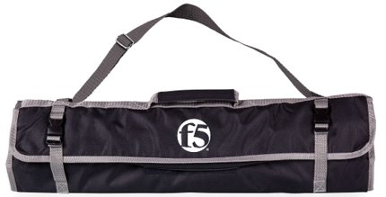
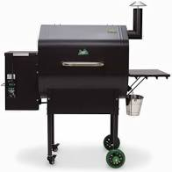
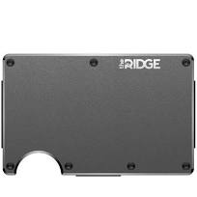

SMOKE THE COMPETITION CHECKPOINTS
Complete
the
challenge
7/22 - Kickoff Call
8/12 - Mitigate OWASP Top 10
9/02 - NGINX KIC
9/23 - Bots & App Fraud
10/14 - Putting it all together

Slide 24


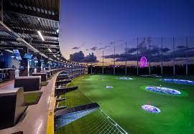
F5 AND HASHICORP TECH FAIRS
Join the
fun
Bay Area
Sacramento
Portland

Slide 25
How to SMOKE THE COMPETITION
Activity/Task | Points Earned
Attend Checkpoint Calls | 200 / Call
Complete a Task (Two per checkpoint) | 100 / Task
Register PIO Opportunity by 10/18 | 500 / Opportunity
Close PIO Opportunity by 10/18 | 1,000 / Opportunity

Slide 26
Join the leaderboard
and get paid
$$$
500 Points – Register an opportunity by 10/8
$200 – Shadow a meeting to discuss opportunity
$200 – Demo a solution during the meeting
1000 Points – Book the deal by 10/8

